Slide 1
Objectives
After completing this chapter you will be able to understand:
  What is an Servlet Event Listener?
  Types of Event Listeners.
  When & How to use Event Listeners?

Slide 2

A Problem statement
Tim was developing an application where he has a requirement to allow only one session created per user. So if Tim logs in from two different desktops a message to be displayed to the user “Cannot log in multiple desktops.”
Guess how Tim would have achieved it?
He used event listener.

Slide 3
What is an Event Listener ?
Listeners are used to perform some logic on trigger of certain events.
Listeners are java classes that is used to implement the event handling mechanism.
Example for Listener:
Listener class can be used for recording/ auditing user login information's.
  Example: “Jack Logged in the application at 8:30 AM”
Listener classes can be used to clean up session objects and free memory when user logs off.

Slide 4
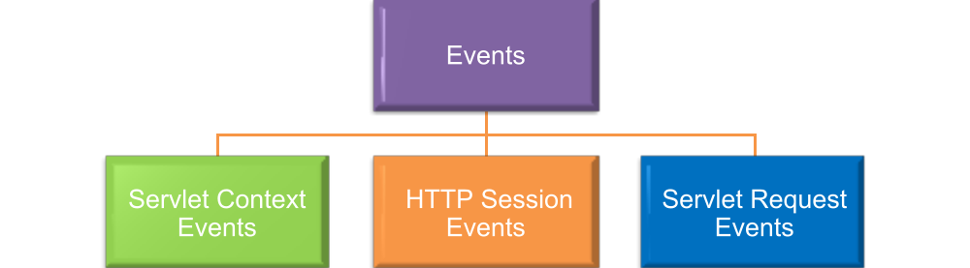
Classification of Events
These are events triggered when there is a change in the ServletContext object.
These are events triggered when there is a change in the Session object.
These are events triggered when there is a change in the Request object.

Slide 5
When are Events triggered?
The events are triggered under two circumstances,
1 . Lifecycle changes - If there is a lifecycle change on the object. Say session created (or) initialized (or) destroyed.
2. Attribute changes - Any attribute stored/changed in the session. Say a attribute “message” is stored in the session.
Who triggers the events?
Whenever one of the changes mentioned above happens the events are triggered by the web container which can be captured by listeners to perform a logic.

Slide 6


Tim’s Problem Solved
Lets check how Tim solved the problem using the event listener.
Web container
1. Tim Logs in the application from desktop 1
2. Login servlet creates
Session for Tim
Login
3. Web container triggers an session created event.
Desktop 1
5. Tim Logs in from desktop 2
Login Listener
Tim
4. Login Listener receives
the event and process it.
6. Web container creates another session created event.
Desktop 2
When Step 6 is executed the Login Listener can receive the event and perform a check whether Tim has already logged in if so it can display the message “Cannot log in multiple desktops.”

Slide 7
Servlet Context Events
Event Trigger | Interface | Method
When Servlet context is created. | javax.servlet. ServletContextListener | contextInitialized( ServletContextEvent sce)
When Servlet context is removed (Web Server shut down). | javax.servlet. ServletContextListener | contextDestroyed( ServletContextEvent sce)
An attribute is added to servlet context. | javax.servlet. ServletContextAttributesListener | attributeAdded( ServletContextAttributeEvent scae)
An attribute is removed from servlet context. | javax.servlet. ServletContextAttributesListener | attributeRemoved( ServletContextAttributeEvent scae)
An attribute is replaced in servlet context. | javax.servlet. ServletContextAttributesListener | attributeReplaced( ServletContextAttributeEvent scae)
This slide lists the types of Servlet context events triggered when changes happen in ServletContext.
The event listener class must implement this interface to respond to each of the servlet context events.

Slide 8
ServletContextEvent Classes
The servlet container creates a javax.servlet.ServletContextEvent object and passed as an input for methods in ServletContextListener class.
The ServletContextEvent class provides the following methods to access the servlet context,
ServletContextEvent.getServletContext()
This method can be used to retrieve the servlet context object that was created or is about to be destroyed.

Slide 9
ServletContextEvent Example
Example :
The following code can be added to a user created listener class “DemoListener” which implements the ServletContextListener interface, this will be triggered when the context is initialized.
void contextInitialized(ServletContextEvent sce)
{
// Accesses the servlet context as below.
ServletContext context=sce.getServletContext();
}

Slide 10
ServletContextAttributeEvent Class
The container creates a javax.servlet.ServletContextAttributeEvent object that is passed as a input for the methods in the ServletContextAttributeListener class.
The ServletContextAttributeEvent has the following methods for accessing the attribute being set in the servlet context.
String getName() : Retrieves the name of the attribute that was set, removed, or replaced in the servlet context.
Object getValue() : Retrieves the value of the attribute that was added, removed, or replaced. In the case of an attribute that was replaced, this method returns the old value, not the new value.

Slide 11
ServletContextAttributeEvent Example
Example :
The following code can be added to a user created listener class “DemoListener” which implements the ServletContextAttributesListener interface. This will be triggered when a new attribute is set in the context.
void attributeAdded(ServletContextAttributeEvent scae)
{
// This returns the value set in the attribute
String attributeValue=scae.getValue.toString();
}

Slide 12
HTTP Session Events
Type of Event | Interface | Method
When an HTTP session is activated. | javax.servlet.http. HttpSessionListener | sessionCreated( HttpSessionEvent hse)
When an HTTP session is about to be passivated. | javax.servlet.http. HttpSessionListener | sessionDestroyed( HttpSessionEvent hse)
When an attribute is added in the Session. | javax.servlet.http. HttpSessionAttributeListener | attributeAdded( HttpSessionBindingEvent hsbe)
When an attribute is removed from the session. | javax.servlet.http. HttpSessionAttributeListener | attributeRemoved( HttpSessionBindingEvent hsbe)
When an session attribute is replaced. | javax.servlet.http. HttpSessionAttributeListener | attributeReplaced( HttpSessionBindingEvent hsbe)
The slide lists down the events triggered when state of HTTP session object changes.

Slide 13
HttpSessionEvent Class
The web container creates a javax.servlet.http.HttpSessionEvent object that serves as an input for all the methods in the HttpSessionListener.
The HttpSessionEvent class has the following method which can be used for accessing the HTTP Session,
HttpSessionEvent.getSession() : Used to retrieve the session object that was created or destroyed..

Slide 14
HttpSessionEvent Example
Example :
The following code can be added to a user created listener class “DemoListener” which implements the HttpSessionListener interface. The below method will be triggered when a new Session is created.
void sessionCreated(HttpSessionEvent hse)
{
//This retrieves the reference of the session object created.
HttpSession session=hse.getSession();
}

Slide 15
HttpSessionBindingEvent Class
The container creates a javax.servlet.http.HttpSessionBindingEvent object that serves as a input for the methods in HttpSessionAttributeListener.
The HttpSessionBindingEvent class includes the following methods, which your listener can call:
String getName() : Retrieves the name of the attribute that was added, removed, or replaced in session.
Object getValue() : Retrieves the value of the attribute that was added, removed, or replaced in the session. In the case of an attribute that was replaced, this method returns the old value, not the new value.
HttpSession getSession() : Used to retrieve the session object that was changed.

Slide 16
HttpSessionBindingEvent Example
Example :
The following code can be added to a user created listener class “DemoListener” which implements the HttpSessionAttributeListener interface. The following method will be triggered when a attribute is added to the session.
void attributeAdded(HttpSessionBindingEvent hsbe)
{
// This will retrieve the name of the attributes set in the session
String attributeName=hsbe.getName();
}

Slide 17
Servlet Request Events
Type of Event | Interface | Method
The request is about to go out of scope of the Web application. | javax.servlet. ServletRequestListener | requestDestroyed( ServletRequestEvent rre)
The request is about to come into scope of the Web application. | javax.servlet. ServletRequestListener | requestInitialized( ServletRequestEvent rre)
Invoked when an attribute is added to the request. | javax.servlet. ServletRequestAttributeListener | attributeAdded( ServletRequestAttributeEvent srae)
Invoked when an attribute is removed from the request | javax.servlet. ServletRequestAttributeListener | attributeRemoved() ServletRequestAttributeEvent srae
Invoked when an attribute is replaced from request | javax.servlet. ServletRequestAttributeListener | attributeReplaced(ServletRequestAttributeEvent srae)
The slide lists down the events when a request to the servlet occurs (or) request attribute changes.

Slide 18
ServletRequestEvent Class
The container creates a javax.servlet.ServletRequestEvent object which serves as a input for the methods in the ServletRequestListener class.
The ServletRequestEvent class has the following methods to access the servet request
getServletContext() : Returns the ServletContext of this web application.
getServletRequest() : Returns the ServletRequest object of the client request.

Slide 19
ServletRequestEvent Class Example
Example :
The following code can be added to a user created listener class “DemoListener” which implements the ServletRequestListener interface. This will be triggered when the request object is destroyed.
void requestDestroyed(ServletRequestEvent rre)
{
// This returns the reference of the servlet request object
ServletRequest request=rre. getServletRequest()
}

Slide 20
ServletRequestAttributeEvent Class
The container creates a javax.servlet.ServletAttributeEvent object that is passed as a input for the methods in ServletRequestAttributeListener methods.
The ServletRequestAttributeEvent class has the following methods,
getName() : Returns the name of the attribute that changed on the ServletRequest
getValue() : Returns the value of the attribute that has been added, removed or replaced.

Slide 21
ServletRequestAttributeEvent Example
Example :
The following code can be added to a user created listener class “DemoListener” which implements the ServletRequestAttributeListener interface. The following method will be triggered when an attribute is added to the Servlet request.
attributeAdded(ServletRequestAttributeEvent srae) {
//used to access the value which was set in the request attribute.
Object attributeValue=srae.getValue();
}

Slide 22
Additions in Servlet 2.5
The Servlet 2.5 specification has two additional Listeners
javax.servlet.http.HttpSessionBindingListener
javax.servlet.http.HttpSessionActivationListener
These interfaces are implemented by objects that are stored as session attributes and do not require registration of an event listener in web.xml.
Associates interested can explore the web to get more details on these.

Slide 23

Developing a Servlet Listener
Step 1 : Create the listener class
This is done by implementing the required servlet listener interface by a normal java class and overriding all the methods.
Step 2 : Make an the listener entry in the web.xml file.

Slide 24
Lend a Hand – Session Attribute Listener
In this demo we will see how the session attribute listener works when attributes are added , removed and replaced in the session object.
Login.html : Login page for the user
LoginController : The action controller for the login page.
Home Servlet : The home page for the user after successful login.
Logout Servlet : Triggered when the logout link is clicked , used for logging out from the application. The session object will be removed from the servlet.

Slide 25
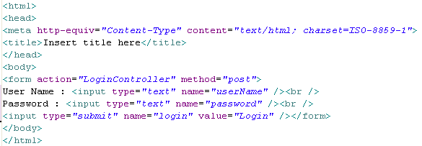
Lend a Hand – Login Html
Develop the login page as given below.
It should have the following fields,
Username
Password
Submit button , submit action should be the LoginController servlet.

Slide 26
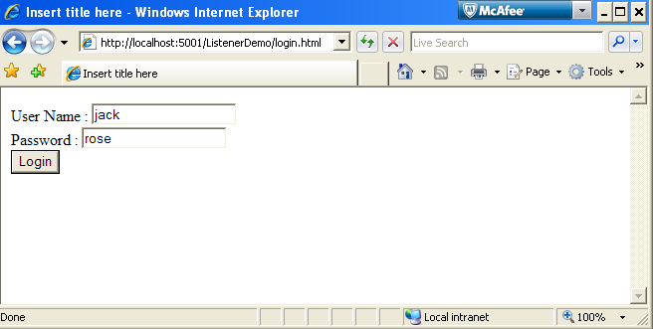
Lend a Hand- login html Screen shot

Slide 27
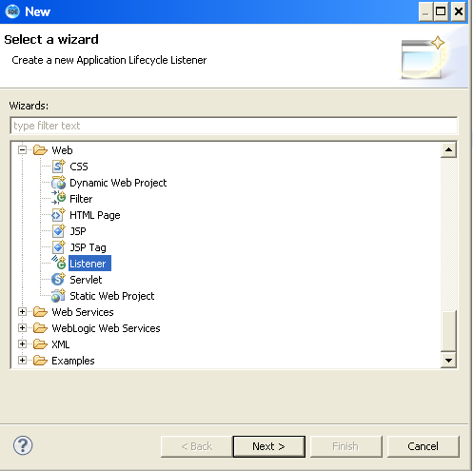
Lend a hand – Create a Session Listener.
Right click Source folder in eclipse →src→Click new→Select Listener

Slide 28
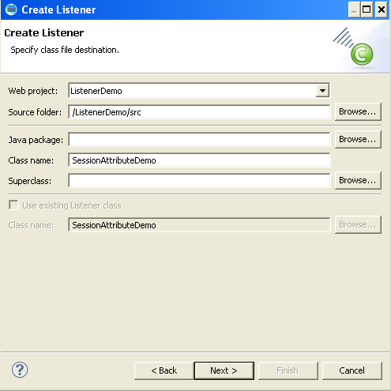
Lend a Hand – Creating Listener (Cont)
Specify the Listener name

Slide 29
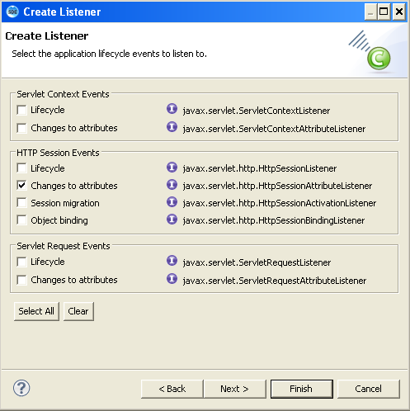
Lend a Hand – Creating Listener (Cont)
Select the Listener Type. In this case we select “Changes to Attributes” under HTTP Session events and click finish.
HttpSessionAttributeListener Selected

Slide 30
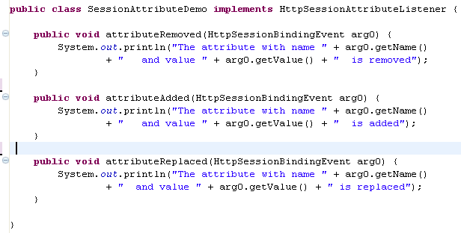
Lend a Hand – SessionAttributeDemo Listener
Add statements to print the session values in the methods as mentioned below.

Slide 31
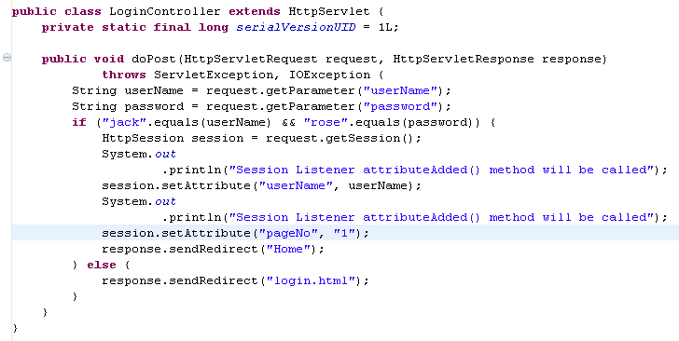
Lend a Hand – Develop LoginController
Create the servlet as mentioned below, set some values in session to demonstrated the session Listener events being triggered.

Slide 32
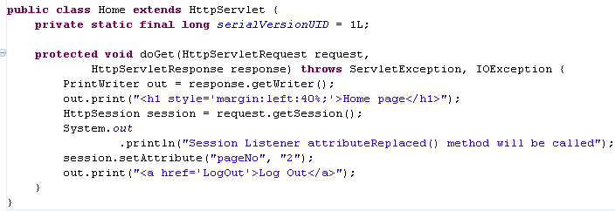
Lend a Hand – Home Servlet
Create the servlet as mentioned below, replace the pageNo values in session to demonstrated the session Listener replace event being triggered.

Slide 33
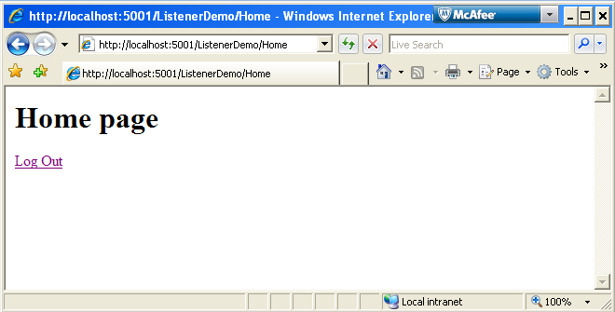
Lend a Hand – Screen Shot Home Page

Slide 34
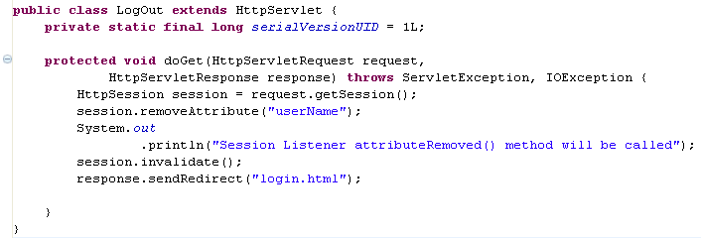
Lend a Hand – Logout Servlet
Create the servlet as mentioned below, remove the attribute and invalidate the session this is to demonstrate the session remove event triggered.

Slide 35
Lend a Hand - Deploy and Run
Step 1 : Deploy and run the application
Step 2 : Invoke the login.html from the browser
http://localhost:5001/ListenerDemo/login.html
Step 3 : Enter “jack” as username and “rose” as password and click Login
Step 4 : View Eclipse console (next slide shows the screen shot).

Slide 36
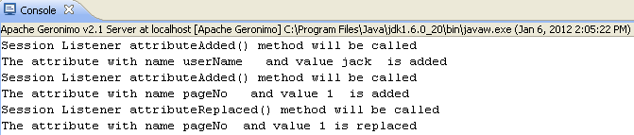
Lend a Hand –Console Output
Login button Clicked : The session attribute listener’s attributeAdded method was invoked for each session attribute is added to session.
Home page Displayed: The session attribute listener’s attributeReplaced method was invoked when the attribute “pageNo” is replaced.

Slide 37
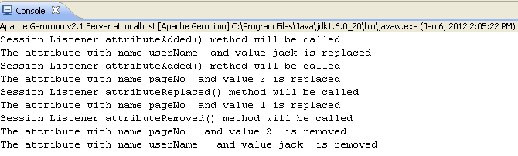
Lend a Hand – Console Output
Step 5 : Click logout from the home page . Now the attributes in the session will be removed and the user will be redirected to the login page.
Step 6 : View the Eclipse Console.
The session attribute listener’s method attributeRemoved invoked when the session is invalidated.

